Slide 1
Vaccine Preventable Disease Trends in Pennsylvania and the Role of Coalitions
6/12/2025
Tom McCleaf, Director
Bureau of Immunizations

Slide 2
School
Immunization
Statistics Update

Slide 3
Kindergarten Comparison, Pennsylvania
Data from SILR (School Immunization Law Report)

Slide 4
7th Grade Comparison, Pennsylvania
Data from SILR (School Immunization Law Report)

Slide 5
12th Grade Comparison, Pennsylvania
Data from SILR (School Immunization Law Report)

Slide 6
Exemptions, Pennsylvania
‘19-’20
‘21-’22
‘23-’24
Pennsylvania, ‘18-’19
‘20-’21
‘22-’23
Kindergarten
Medical 0.4% 0.4% 0.3% 0.3% 0.4% 0.3%
Religious 1.2% 1.2% 1.2% 1.7% 2.0% 2.5%
Philosophical 1.3% 1.3% 1.2% 1.3% 1.4% 1.8%
7th Grade
Medical 0.7% 0.7% 0.8% 0.6% 0.5% 0.5%
Religious 1.5% 1.5% 1.4% 1.8% 2.0% 2.7%
Philosophical 2.0% 2.2% 2.4% 2.4% 2.7% 2.3%
Data from SILR (School Immunization Law Report)

Slide 7
National Immunization Survey (NIS) – Adult COVID Module Data
May – June 2023

Slide 8
NIS Adult COVID Module
Probably or definitely will not get vaccinated:
  Male = 8.1%
  Female = 3.4%
  White, non-Hispanic = 5.5%
  Black, non-Hispanic = 3.6%
  Hispanic = 10.0%
  Insured = 4.8%
  Not insured = 17.0%

Slide 9
NIS Adult COVID Module
Probably or definitely will not get vaccinated:
  Received any vaccine that was not a COVID vaccine in past 2 years = 1.3%
  Did not receive any vaccine that was not a COVID vaccine in past 2 years = 12.6%
  Republican-leaning= 7.6%
  Not Democrat or Republican-leaning= 5.4%
  Democrat-leaning = 4.2%
  Comorbidities, Yes = 2.3%
  Comorbidities, No= 7.9%

Slide 10
NIS Adult COVID Module
Experiences and difficulties with getting a COVID shot:
  Difficulty getting an appointment online
  Difficulty knowing where to get vaccine
  Locations not open at convenient times
  Had a reaction to a previous dose
  Difficulty with cost
  Did not know they were eligible
  Hard to get to the vaccination site

Slide 11
Vaccine-Preventable Disease Resurgence:
Measles

Slide 12
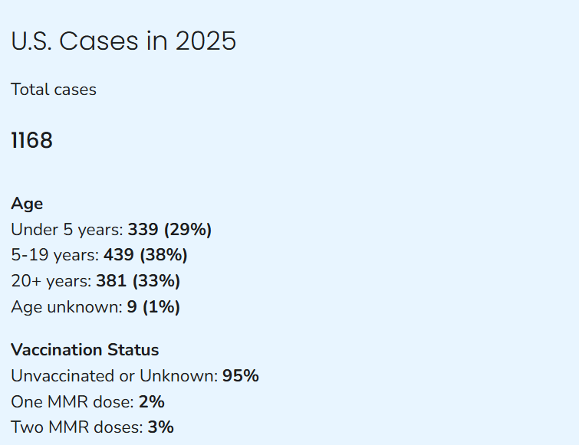
Measles cases in 2025
Per CDC; updated June 6, 2025

Slide 13
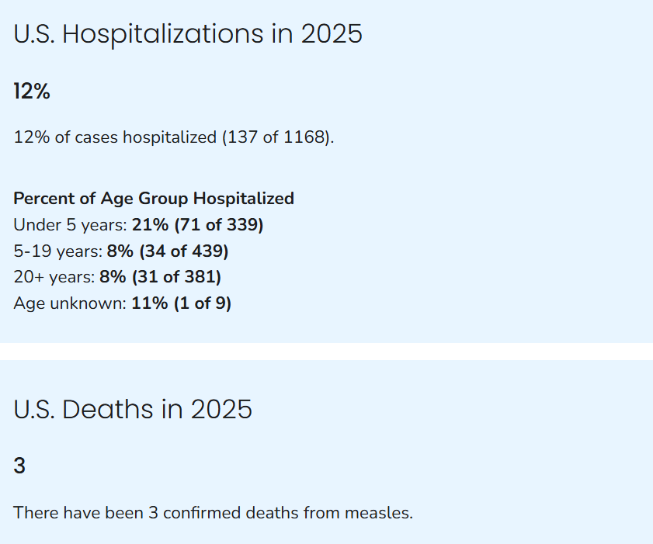
Measles hospitalizations and deaths in 2025
Per CDC; updated June 6, 2025

Slide 14
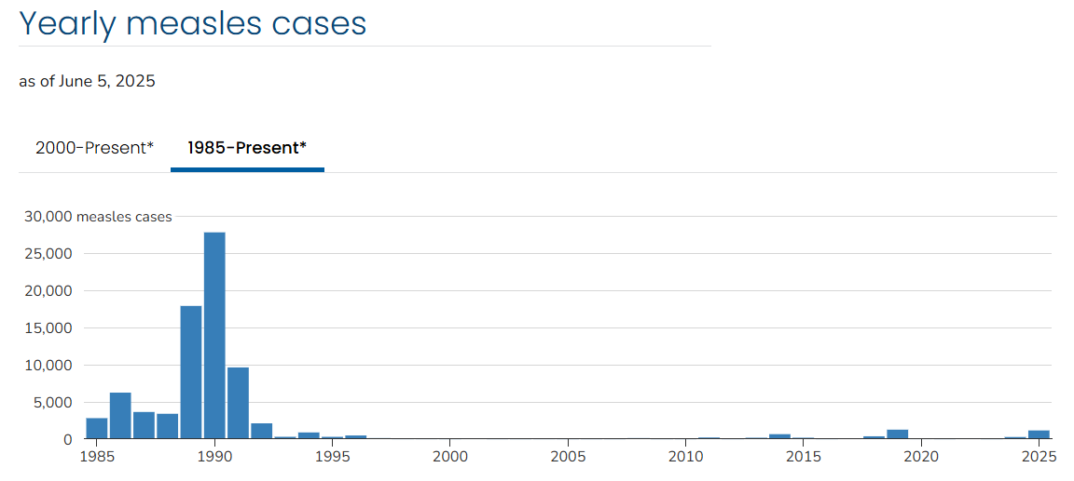
Yearly Measles Cases

Slide 15
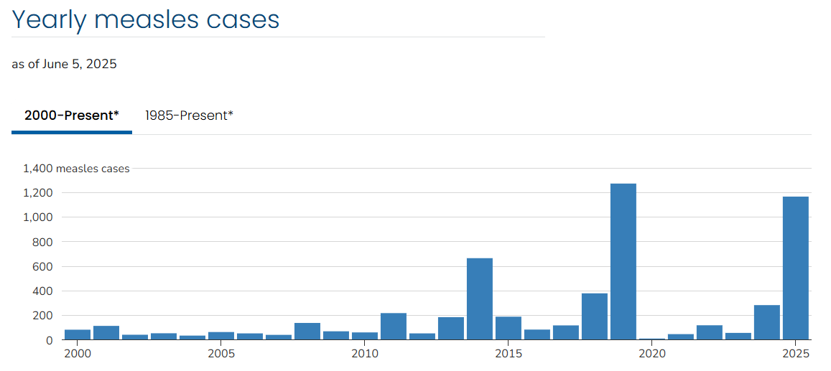
Yearly Measles Cases

Slide 16
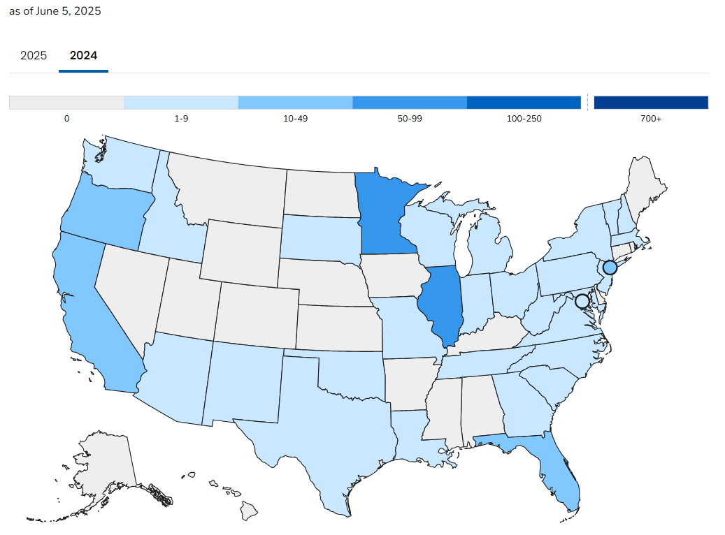
Cases by State, 2024

Slide 17
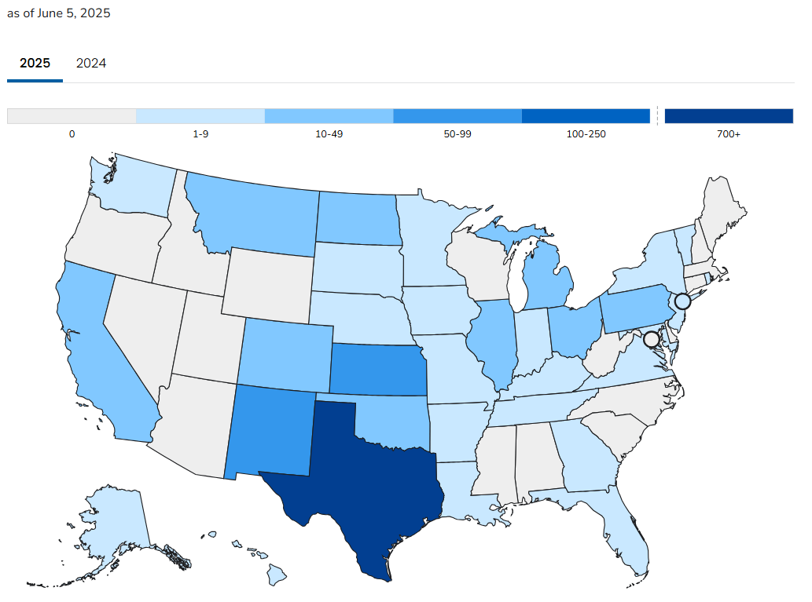
Cases by State, 2025

Slide 18
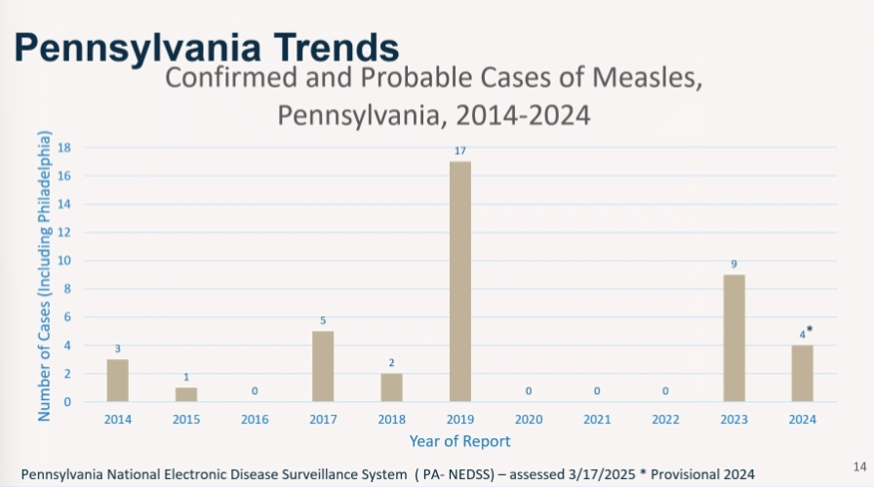

Slide 19
The Role of Coalitions

Slide 20
Immunization Coalition Toolkit

Slide 21
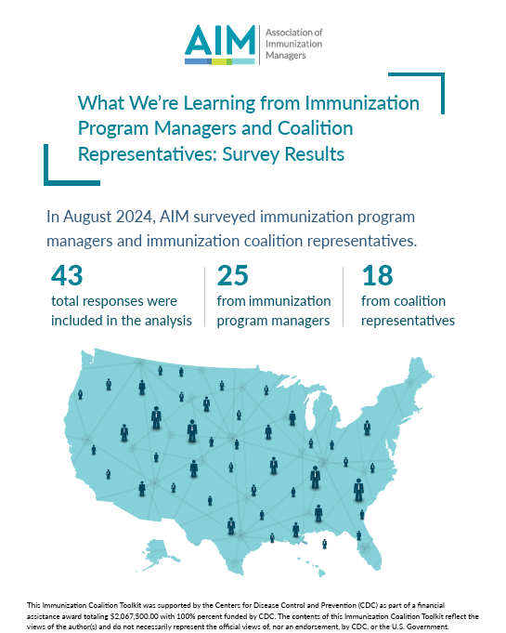
Survey Results and Landscape Analysis

Slide 22

Survey Results and Landscape Analysis

Slide 23
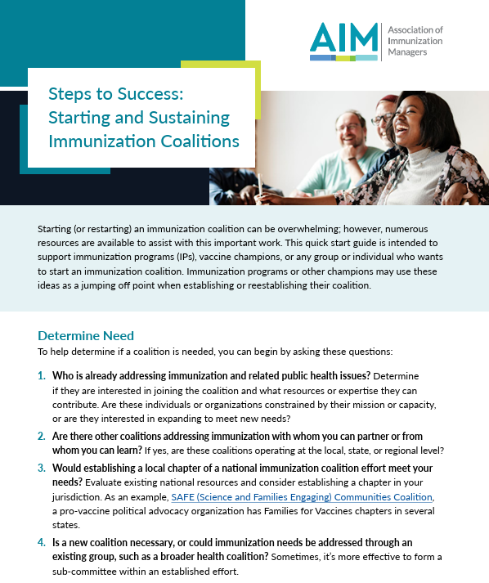
Steps to Success

Slide 24
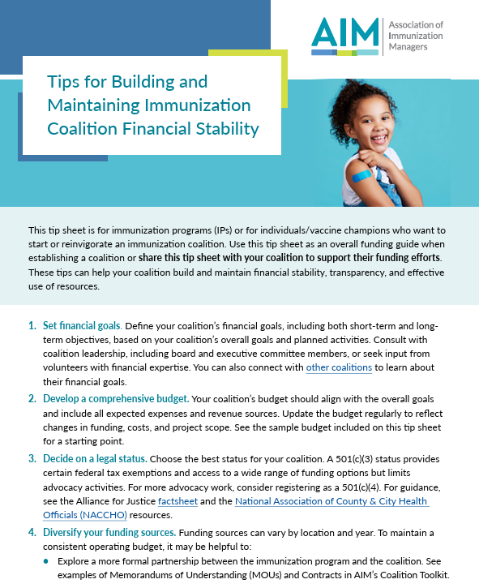
Tip Sheets

Slide 25
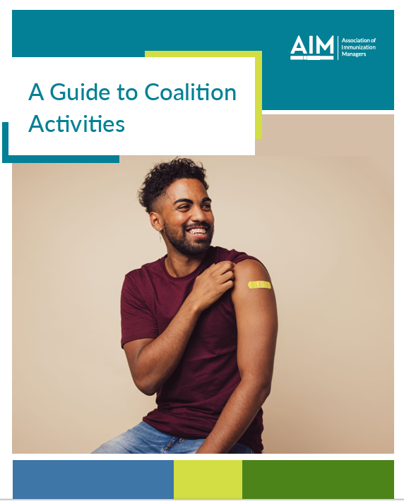
Tip Sheets

Slide 26
Coalition Successes

Slide 27
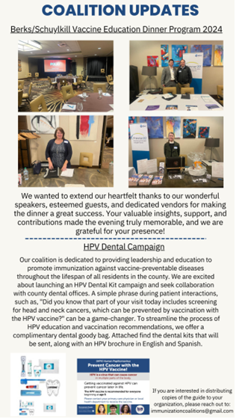
Berks / Schuylkill Immunization Coalitions

Slide 28
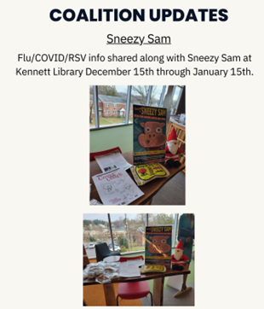
Chester County Immunization Coalitions

Slide 29
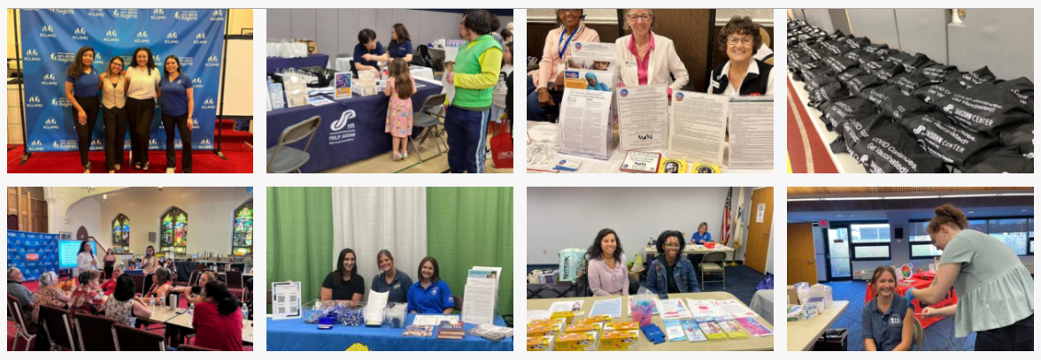

Slide 30
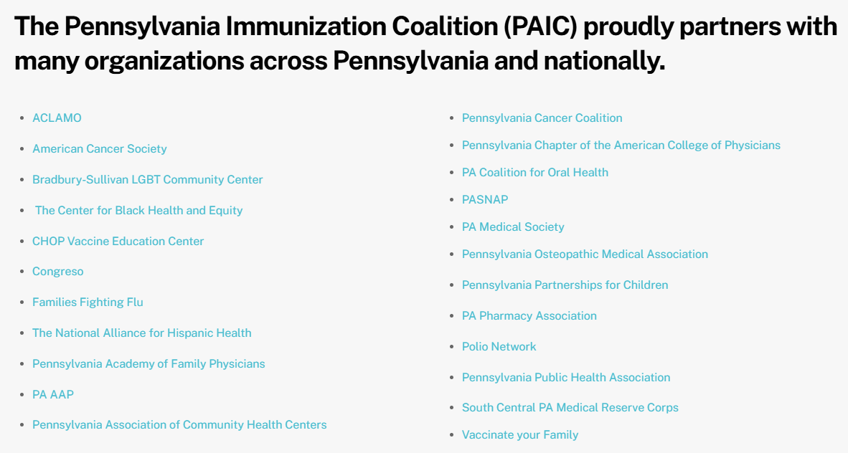

Slide 31

Questions

Slide 32


Thank you!

