Slide 1



Sustainability: Building Pathways for Growth and Long-Term Partnerships
PAIC Annual Meeting
June 12, 2025
Autumn Kieber-Emmons, MD, MPH
Vice Chair, Research
Lehigh Valley Health Network
Chelsea Bufalini, MPH, CHES
Research Project Manager
Penn State College of Medicine
Notes:
[CHELSEA]
Thank you all for inviting Autumn and I to share this presentation with you designed to help you build partnerships to support immunization initiatives across Pennsylvania. We are very excited to share tools and insights to help strengthen the sustainability of your immunization work through partnerships.

Slide 2
Objectives
To identify key elements of partnerships and leverage tools to build capacity for long-term partnerships to promote immunization across Pennsylvania.
To understand funding options that can support long-term partnerships for your work.
To be aware of current challenges to sustaining your vaccine programs.
Notes:
[CHELSEA]

Slide 3



Do not edit
How to change the design
Which of the following best describes your organization?
The Slido app must be installed on every computer you’re presenting from

Slide 4
Do not edit
How to change the design
What experience do you have with collaborative partnerships?
The Slido app must be installed on every computer you’re presenting from

Slide 5

Partnerships Matter for Growth and Sustainability
Increase your impact by broadening reach
Enable resource sharing and access to expertise to empower efficiency and innovation
Provide diverse perspectives to help address complex challenges
Notes:
[CHELSEA]
Partnerships multiply your impact. When we work together, we share resources, expertise, and broaden our reach. Let’s explore how meaningful collaborations create long-lasting health improvements in our communities.

Slide 6
Types of Partners
Clinical: Providers, pharmacies, hospitals, FQHCs
Research: Universities, PBRNs, health systems
Schools: K-12, school boards, parent organizations
Coalitions and CBOs: Faith-based, nonprofits, advocacy groups
Government: Local and state health departments
Notes:
[CHELSEA]
There are many types of partners. Clinical partners help with direct delivery. Researchers help measure impact. Schools and coalitions help with education and outreach. Each plays a vital role in the sustainability ecosystem.

Slide 7
Building Strong Partnerships
Shared cause: Clear mission and purpose
Mutual benefit: What’s in it for each partner?
Trust + Consistency
Notes:
[CHELSEA]
Successful partnerships grow from a shared cause and mutual benefit. It's about more than collaboration—it's about making sure all parties feel seen, valued, and aligned.

Slide 8
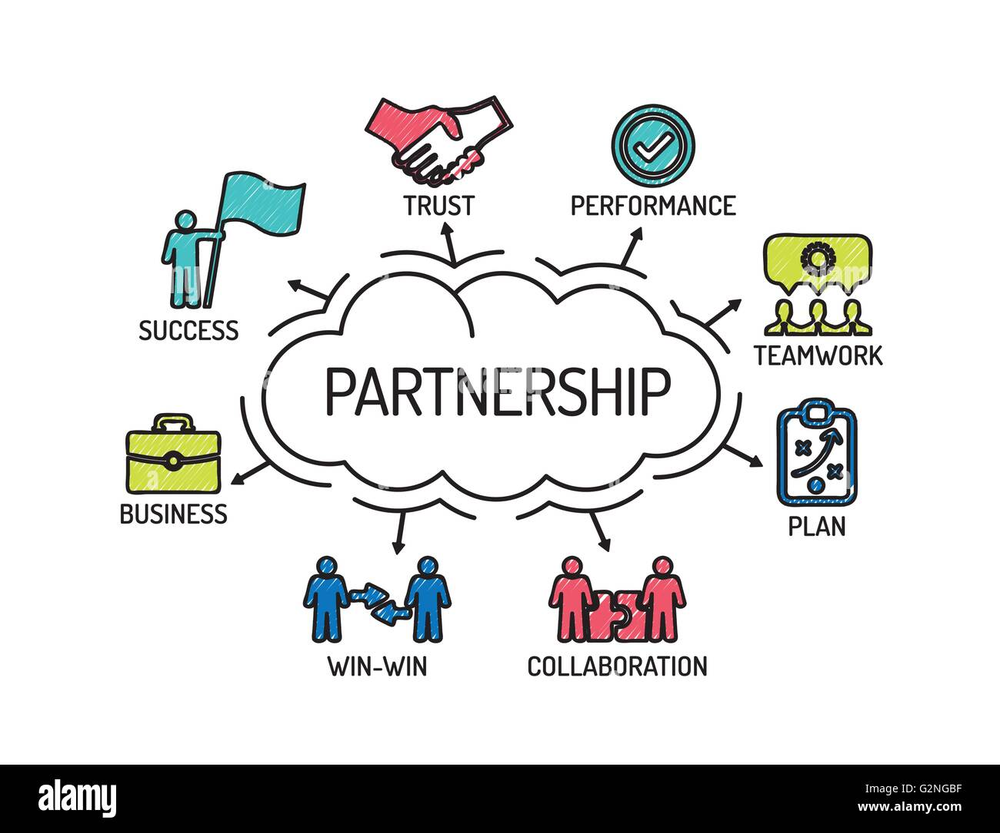
Traits of Effective Partnerships
Bi-directional communication
Clear roles and responsibilities
Regular engagement
Proactive and solutions-focused
Evaluate work and strive to improve
Notes:
[CHELSEA]
Great partnerships have clarity—on goals, roles, and communication. They also celebrate wins together and evolve together.

Slide 9
Steps for Developing Partnerships
Define shared mission
Algn on a common mission with measurable SMART goals.
Map stakeholders
Identify and engage key organization leaders, and community influencers
Establish a structure
Formalize role, decision-making processes, and accountability
Develop a communication plan
Launch project/ program
Measure and share impact
Sustain and evolve
Promote transparency, alignment, and engagement
Work together to host clinics, educational campaigns, or seek new funding
Track progress to create visible wins
Build long-term relationships and adapt over time
Notes:
[CHELSEA]
Based on what we have discussed so far, here are 7 steps to build sustainable, trust-based partnerships among local organizations to improve community immunization rates.
1. Define Shared mission
Objective: Align on a common mission and measurable goals.
Action Steps:.
Identify overlapping priorities (e.g., child health, vaccine access).
Develop a shared goal statement (e.g., “Increase pediatric immunization rates in underserved ZIP codes by 20% in 2 years.”)
2. Map Stakeholders & Assets
Objective: Identify and engage key organizations, leaders, and community influencers.
Tools:
Stakeholder map (FSG or CDC templates)
Asset mapping exercise (who brings what to the table)
3. Establish a Structure
Objective: Formalize roles, decision-making processes, and accountability.
Options:
Steering Committee with rotating chairs
Working groups based on focus areas (e.g., outreach, data, policy)
4. Develop a Communication Plan
Objective: Promote transparency, alignment, and engagement.
Action Steps:
Schedule regular meetings (e.g., monthly check-ins, quarterly retreats)
Create shared digital workspace (Google Drive, Slack, or Basecamp)
Design a shared brand/logo for public-facing materials
5. Launch Collaborative Projects
Ideas:
Joint vaccine clinics or educational campaigns
Shared grant applications
Cross-referral networks
6. Measure & share Impact
Objective: Track progress and celebrate successes.
Key Metrics:
Number of people reached
Vaccination rates
Partner engagement/satisfaction
Tools:
Logic model
7. Sustain and Evolve
Objective: Build long-term commitment and adapt over time.
Action Steps:
Review partnership health annually (surveys, interviews)
Rotate leadership to prevent burnout
Plan for funding sustainability (grants, shared resources)

Slide 10

Activity – Reflect & Share
What is the best partnership you’ve ever been part of?
What made it successful?
Notes:
CHELSEA – Initial presentation:
Let’s pause briefly—take 2 minutes to reflect or turn to a neighbor. Think of the best partnership you’ve ever been a part of. What made it work?
AUTUMN – Group Share:
If a few of you are willing to share out loud, we’d love to hear about your best partnership and what made it successful.

Slide 11
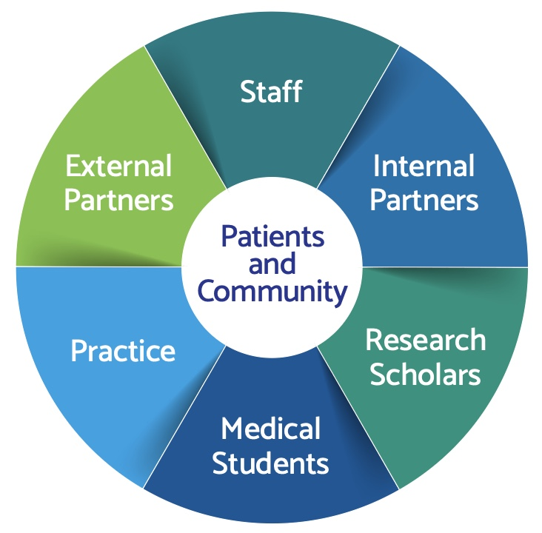
Clinical Partnerships: CBPR & Practice-Based Research Networks
CBPR: Community-Based Participatory Research – Shared leadership and design
PBRNs: Practice-Based Research Networks – Providers helping answer real-world questions
Notes:
[AUTUMN]
Community based participatory research is an integral aspect of research that links clinical practices, communities and community partners, and researchers and institutions/health systems. In the Lehigh Valley, we have a CPBRN where you can see, in this image, that patients and our community lie at the heart of all that we do. Any research is informed and co-created by the patient and community partners, in order to advance health.
CBPR Community Toolbox by Kansas University:
https://ctb.ku.edu/en/table-of-contents/participation/participatory-evaluation/cbpr/main
Practice-Based Research Networks (PBRN) Resource Center – AHRQ:
https://pbrn.ahrq.gov/
Community-Campus Partnerships for Health (CCPH CBPR Resources):
https://ccphealth.org/cbpr-resources/

Slide 12
Research Partnerships
Benefits of Research Partnerships
Participating in clinical trials
Sharing program data
Testing new interventions
Co-authoring publications
Notes:
[AUTUMN]
Being part of research doesn’t always mean running a clinical trial. It might mean collecting data, piloting a new tool, or helping translate findings into practice. There are important benefits on both sides of the research partnership – example - getting to participate in the pursuit of new clinical knowledge with access to cutting edge treatments in clinical trials (example Pfizer Covid vaccine study at LVHN), sharing data between institutions across the state and seeing what other regions may be doing well in/could learn from, and getting to have chance to write papers that the medical community will read about your findings.

Slide 13

Being a Good Community Partner
Show up consistently
Honor lived experiences
Be transparent
Focus on co-creation, not top-down models
Notes:
[AUTUMN]
Partners bring their authentic selves to the table. As a community partner, showing up, honoring your experience and voice, being clear and transparent with what you can offer and what you need, and focusing on co-created roles, with everyone bringing something to share at the table. Research partners need to do the same. They bring research skills, resources, pathways for advocacy or institutional buy-in.

Slide 14

Leveraging Partnerships for Funding
Government grants (CDC, HRSA, state DOH)
Philanthropy (local foundations, United Way)
Healthcare system/community benefits
Fee-for-service in clinical settings
Notes:
[AUTUMN]
How to find funding to continue and grow your partnerships' reach. Only can do so much if it is voluntary or on borrowed time. Grants may be the first idea that comes to mind, but there are other creative funding/revenue streams to consider as well for your partnership.

Slide 15
Potential Funding Streams
Grants.gov (Federal health grant search):
  https://www.grants.gov
HRSA Grant Opportunities (includes immunization programs):
  https://www.hrsa.gov/grants
Immunize.org Funding Page (for vaccine programs):
  https://www.immunize.org/partners/funding-resources.asp
Notes:
[AUTUMN]
There has been a change in national funding priorities and vaccination is not one of those priorities. This has made funding for this kind of work to be more competitive due to the limiting funding options. However, These are still three potential areas to search for available funding streams.

Slide 16
Current Threats to Vaccine Programming
Funding Uncertainty
  Expiring pandemic-era support
  Termination of government funding
Misinformation + Distrust
Clinical Threats:
  Science outpacing public understanding
  New vaccines are raising new concerns
Notes:
[AUTUMN]
Today's presentation comes at an extremely volatile time in terms of the healthcare landscape, the rise of AI and social media information, and the current US political climate. All of these current contextual elements are potential threats to partnerships on vaccine-related work. Sure you have heard of vaccine research grants being stopped, covid vaccination misinformation being spread, and growing distrust between patients and their providers.

Slide 17
Overcoming These Threats Together
Advocate for sustained investment!
Engage your local policymakers to prioritize immunization programming
Find Partners you can stick with through the shifting tides around you
Leverage your shared values and shared goals
Be creative and diversify your funding planning
Lift up the voice of your community to combat misinformation and distrust
Use trusted messenger campaigns
Consider foundation funding, or even local large employers and insurers
Notes:
[AUTUMN & CHELSEA]

Slide 18
Partner Assessment and Mapping
Partnership Assessment Tool for Health (PATH) (PDF):
Purpose: Helps assess and improve the quality of collaborative efforts
The Partner Tool by Visible Network Labs (interactive mapping):
Purpose: Creates a visual map of interactions with partners, helpful when you have multiple partners
Notes:
[CHELSEA]

Slide 19
Resources for Partnerships
Community Tool Box – University of Kansas:
Purpose: Provides education resources on partnership building, coalition development, communication strategies, and leadership.
CDC Partnership Agreement Template
Purpose: Provides a sample MOU template to outline shared goals, roles, and expectations.
Notes:
[CHELSEA]

Slide 20

Summary
Explore the different types of partners.
Leverage your skills and expertise to solidify your organization as an asset in partnerships.
Utilize existing tools and resources to build long-term partnerships.
Seek shared wins and overcome challenges together - We are stronger together!
Notes:
Focus on building partnerships that last beyond any one program or grant.

Slide 21
Questions?

