Slide 1
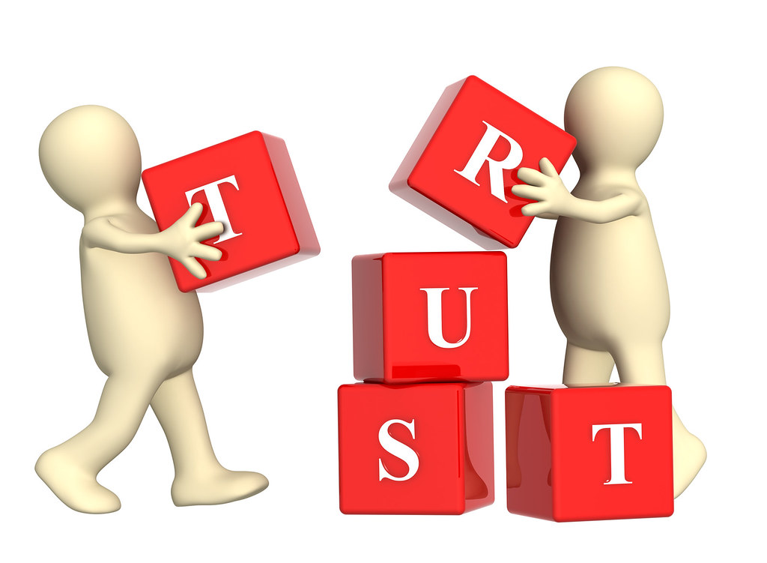
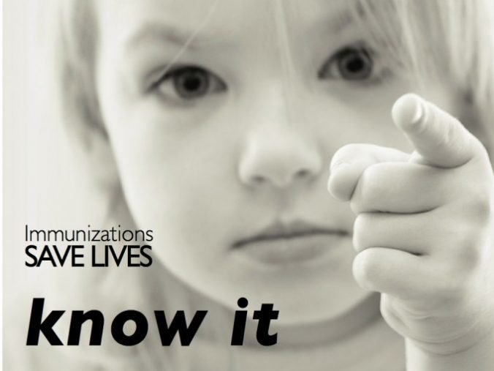
Building Trust, Saving Lives:
The Path to Vaccine Confidence
This Photo by Unknown Author is licensed under CC BY
Madalyn Schaefgen, MD, FAAFP
Vice Chair, PA Immunization Coalition Board
June 12, 2025
This Photo by Unknown Author is licensed under CC BY-SA

Slide 2
Learning Objectives
Describe vaccine hesitancy.
Explain effect of change on people’s decision-making ability
Use motivational interviewing to address vaccine hesitancy
Recognize misinformation versus science-based evidence-based knowledge
Learn about media monitoring

Slide 3
Definitions
Misinformation – inaccurate or misleading information (unintentional)
Disinformation – deliberate spread of false information (for profit/politics/power)
Malinformation – genuine or accurate info used with intent to cause harm
Infodemiology - The study of the spread of information with the goal of improving public health

Slide 4
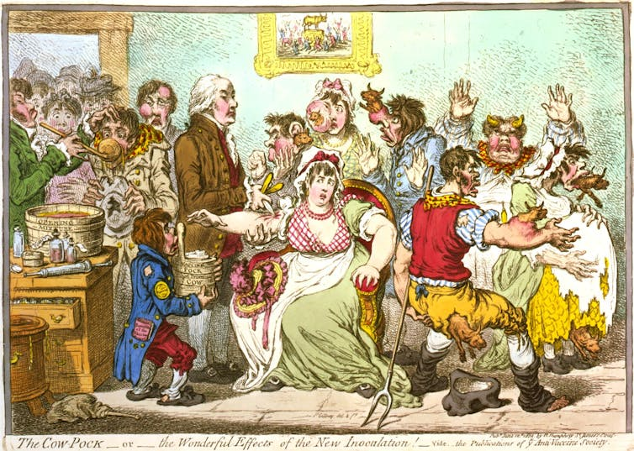
This Photo by Unknown Author is licensed under CC BY-SA
Notes:
Misinformation, disinformation and vaccine hesitancy are not new. This is a cartoon showing the perceived effects of the cowpox vaccine – turning into a cow, growing abnormal cow parts…

Slide 5
Vaccine Mistrust – Ancient and International
Hesitancy predates vaccines - 1000s - variolation to prevent smallpox
1796 – first vaccine introduced by Jenner, preventing smallpox by injecting people with cowpox
1809 - first known mandatory vaccination law, smallpox vaccine in MA
1879 - founding of the Anti-Vaccination Society of America
1905 Supreme Court decision Jacobson v. Massachusetts upheld a state’s right to mandate vaccines
Notes:
Variolation staved off serious smallpox infections by triggering mild infection through exposure to material from an infected person — dates back to at least the 1000s in Asia, Africa and other parts of the world.
Smallpox vaccination introduced by Jenner in 1706 was met with vaccine hesitancy by Benjamin Franklin (who later regretted it when smallpox killed his youngest son) and by many others. Onesimus, an enslaved man in Boston, taught the procedure to Puritan minister Cotton Mather, who in turn urged doctors to inoculate the public during a 1721 smallpox outbreak. Many refused, and Mather faced hostility: A small bomb was thrown through his window. Reasons given for avoiding variolation — particularly that it was unnatural to interfere with a person’s relationship with God — were the seeds of later anti-vaccination attitudes.
In 1809, Massachusetts passed the world’s first known mandatory vaccination law, requiring the general population to receive the smallpox vaccine. Resistance began to grow as other states passed similar laws.
U.K. Vaccination Act of 1853 required parents to get infants vaccinated by 3 months old, or face fines or imprisonment. The law sparked violent riots and the formation of the Anti-Vaccination League of London. Vaccine resisters were often poor people who received little health care and who were suspicious of a forced medical intervention. Anti-vaccination groups argued that compulsory vaccination violated personal liberty.

Slide 6

C
H
A
N
G
E
Stages of the Change Curve
Shock & Denial
Anger & Depression
Acceptance & Commitment
Notes:
Decision making is stressful. Change is inevitable and stressful. This picture reminds me of my 2 trips to Alaska and seeing the huge changes in the glaciers in the intervening 25 years. People respond to involuntary changes in the external environment similar to grief. The Change Curve is based on a model originally developed in the 1960s by Elisabeth Kubler-Ross to explain the grieving process.
1. Shock and denial – inability to process, think it won’t affect them
2. Anger and depression – frustration over lack of control (over virus/vaccine); depression over the choices to vaccinate or not (and don’t forget that choosing not to vaccinate is a choice)
3. Acceptance and Commitment – accept that change is inevitable and can focus on moving forward. This is the time to discuss the positives.
Voluntarily making a decision to accept a vaccine is also a change, which is scary and causes anxiety in a lot of people. This results in people hesitating to accept a vaccine.

Slide 7
Changes increasing vaccine hesitancy
Government lack of support for vaccines (skeptics, decreased funding, changes in way vaccines are tested, approved)
Communication regarding vaccines expanded outside the clinician-patient relationship
Technology – Exponential rise in ability to reach larger and larger audiences through digital and social media; electronic, instantaneous, anyone can be influencers
Science of vaccines – new platforms, rapid development, increased number, complexity of schedules
Increase in quest for health autonomy and personal freedom (a change in medicine from paternalism to informed consent and shared decision making)
----------------------------------------------------------------------------------------
Public distrust of government and health organizations
Success of vaccines and the game theory
  Decline in risk of exposure to infectious diseases
  Risk of vaccines perceived to be higher than risk of disease
  Fundamental tension between individual choice and collective welfare
Notes:
In the past 50 years we’ve had TV, newspapers, etc with vaccine disinformation. 1982 news documentary called “DPT: Vaccine Roulette”, shared emotional stories of parents claiming their children had suffered seizures and brain damage from DPT shot. Interviews with doctors led credence to the false claims.
British gastroenterologist Andrew Wakefield published a report in the Lancet alleging that the measles-mumps-rubella, or MMR, vaccine caused autism spectrum disorder in 12 children. Wakefield falsified data, violated informed consent and secretly invested in development of a solo measles vaccine.
1999, the U.S. Public Health Service recommended removing thimerosal from childhood vaccines. Note MMR never contained thimerosal and no brain damage known from thimerosal (ethylmercury) which is broken down and excreted much more rapidly than methylmercury found in the environment. think about ethanol and methanol (also known as ethyl alcohol and methyl alcohol), you will see that the difference can be dramatic – ethanol is what we drink at a party, whereas methanol, added to some types of gasoline and antifreeze, is poisonous if consumed.
2016’s Vaxxed: From Cover-Up to Catastrophe, directed by Wakefield, promoting disinformation under guise of documentary
The “Disinformation Dozen” produce 65% of the shares of anti-vaccine misinformation on social media platforms, concluded the nonprofit Center for Countering Digital Hate, and include Joseph Mercola, who sells dietary supplements, and his business partner Erin Elizabeth, who runs an alternative-health website. Also listed is Robert F. Kennedy Jr., the son of the late Sen. Robert F. Kennedy and chairman of Children’s Health Defense, an anti-vaccine group, now Secretary of HHS.
Government lack of support for vaccines
Leadership – skeptical of vaccines – RFK Jr as head of HHS, David Geier, as head of federal autism and vaccine investigation
Vaccine testing and approval framework changing for FDA, including recent changes in way Novavax Covid vaccine limited by FDA (previously a role that CDC performed).
Funding for vaccines and vaccine research, including loss of NIH funding to study vaccine hesitancy, stop mRNA vaccine funding and add single flu vaccine based on 1970s technology.
Spending on research to discount vaccines – pledged NIH grant of $50 million to help identify environmental causes of autism, Yet during the first four months of 2025, the NIH has reduced funding for autism-related research by an estimated $31 million to $116 million from $147 million in the same period in 2024.

Slide 8
What factors influence decisions about vaccination?
Contextual | Individual and group influences | Vaccine/vaccination -specific issues
Media and public communication Local politics Religion, culture Accessibility of services Trust in authorities | Beliefs and attitudes about health and disease prevention Knowledge and awareness Poor quality health service experience | Mode of administration Source of the vaccine Vaccination schedule Any costs associated with vaccination Knowledge/attitudes of healthcare professionals
Notes:
Know your enemy! We need to know what factors influence decisions about vaccines. As you can see, it is multifactorial, so we need to approach each person as an individual to find out which of these is influencing their decision. We are going to talk about a few of these (media, trust, vaccines) along with change and motivational interviewing.

Slide 9
Factors contributing to vaccine hesitancy
Complacency
Low perceived risk of vaccine-preventable diseases, and vaccination not deemed necessary. Other life/health issues are a greater priority
Convenience
Barriers related to geographic accessibility, availability, affordability, and acceptability of services
Confidence
Low levels of trust in vaccines, in the delivery system, and in health authorities
Notes:
Factors contributing to vaccine hesitancy are complex, primarily involving 3 areas: complacency, confidence and convenience. Confidence and trust is the area in which we will focus this talk.

Slide 10
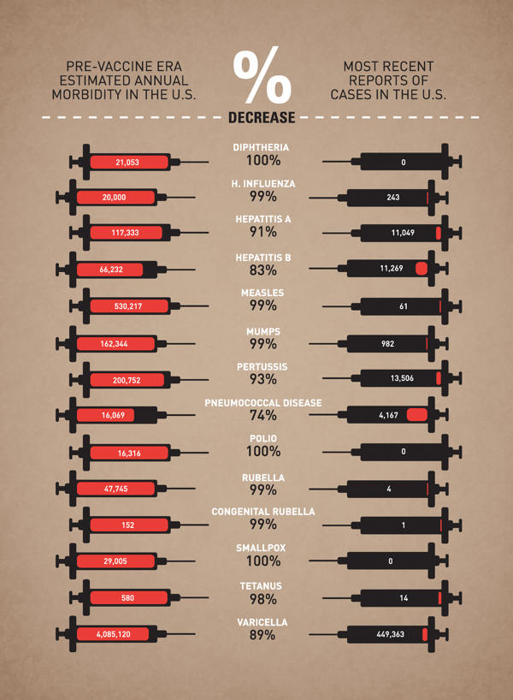
Vaccines
Work!
https://www.thetraveldoctor.com.au/wp-content/uploads/2013/02/Blog-vaccinesinfo-graphic-1.jpg
This Photo by Unknown Author is licensed under CC BY-ND
Notes:
I’m preaching to the choir here, but this is an older graphic from 2013 which you’ve likely seen, showing vaccines work. But just giving the facts doesn’t ensure success in goal to vaccinate. So what does work?

Slide 11
Vaccine Hesitancy
Complex issue
Address through motivational interviewing
Notes:
The problem of vaccine hesitancy has become increasingly prevalent over the past decade, posing a significant challenge to public health, and has been named among the top 10 public health threats by the World Health Organization (WHO)

Slide 12
What is vaccine hesitancy?
HESITANCY
ACCEPT BUT UNSURE
REFUSE BUT UNSURE
ACCEPT ALL
ACCEPT SOME, DELAY AND REFUSE SOME
REFUSE
ALL
A delay in acceptance or refusal of vaccines, despite availability of vaccination services
Complex and context specific, varying across time, place and vaccine

Slide 13

Addressing vaccine hesitancy
No single strategy can address all of the different dimensions of hesitancy
What health workers (HW) say and how they interact with the patient/caregiver can strongly influence vaccine acceptance
This Photo by Unknown Author is licensed under CC BY-SA
Notes:
What you say and how you say it makes a difference. If you gain their confidence, you may be able to make a difference.

Slide 14
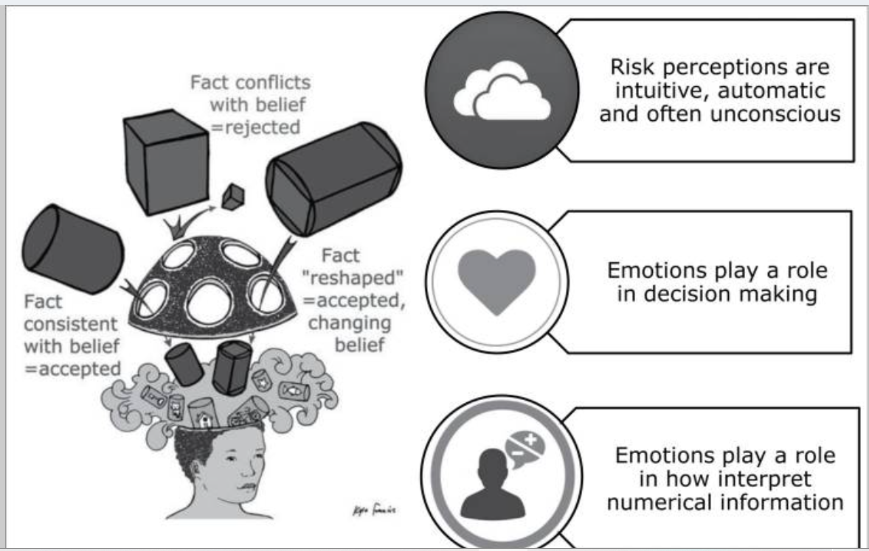
What doesn’t work
Repeating myths (reinforces)
Providing unrequested facts (“knowledge deficit” approach)
Emphasizing dangers of not vaccinating (fear)
Using judgmental or dismissive language (shaming)
Failing to personalize communication
Smith JC, Appleton M, MacDonald NE. Building confidence in vaccines. Adv Exp Med Biol. 2013;764:81–98.
What may (or may not) work
Mandates – depending on how they are constructed
Notes:
Vaccine decisions are influenced by emotions, beliefs, or social norms. Emphasizing the dangers of vaccine hesitancy can actually increase fear of adverse events and be ineffective.

Slide 15
What does work
Trust in healthcare providers and institutions
Strong clinician recommendation
Advice from a trusted messenger
Communication - Motivational interviewing – empathetic, respectful, tailored to individual, highlighting shared values and reframing the narrative; broad community campaigns as well as tailored campaigns and approaches including risk communication
Pre and debunking approaches of misinformation and disinformation informed by use of social listening systems
Community engagement – trained vaccine champions
Promotion of vaccines on social media
Reminders
Standing orders
Increased access - Community outreach, home visits, school-based immunization campaigns
Patient incentives

Slide 16
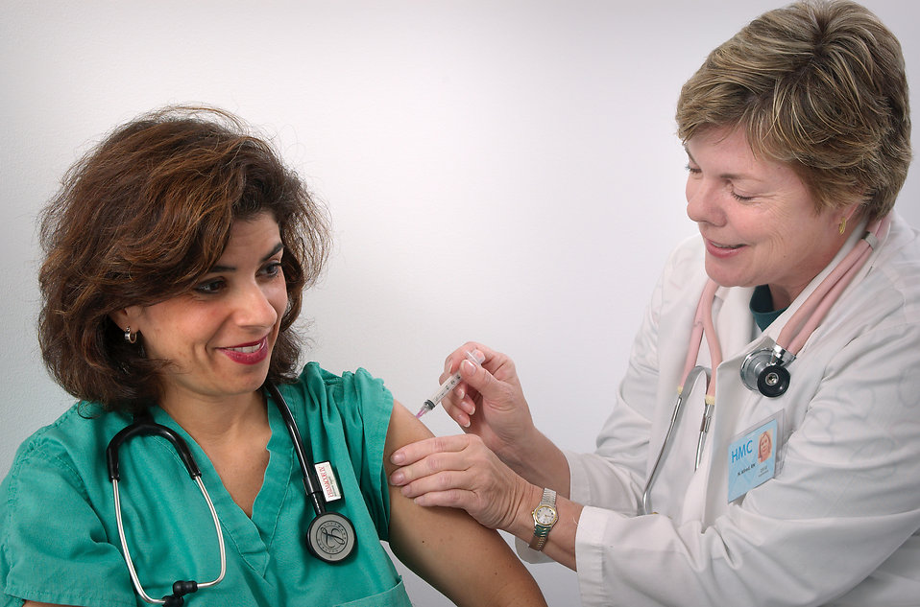
How can a health worker identify hesitant individuals?
Open the conversation with a presumptive statement or announcement, presenting vaccination as a default:
“Now it’s time for _____ vaccines.”
“Today we’ll give _____ vaccines”
Notes:
Starting with a presumptive statement shows it is the norm, expected, and shows your confidence in vaccines and results in increased uptake of vaccines.

Slide 17
If hesitant, how to proceed?
ACCEPT ALL
ACCEPT BUT UNSURE
ACCEPT SOME, DELAY AND REFUSE SOME
REFUSE BUT UNSURE
REFUSE
ALL
Accept all | Vaccine hesitant | Refuse all
Offer positive encouragement:“That is great!” Administer the vaccines | A conversation guided by the MOTIVATIONAL INTERVIEWING method | Do not dismiss from the clinic Not a debate - focus on their concerns Leave space for any discussion Offer to refer to other health professionals who can discuss further (if available) Explain their responsibilities if not accepting vaccination, e.g. not protected against diseases, may get ill, may need specialised health care…, and to watch for signs and symptoms of diseases in the community.
Notes:
If patient is in agreement, administer the vaccine.
If patient refuses all vaccines, be sure that you focus on their concerns, explain that choosing NOT to vaccinate is a choice (just like choosing to vaccinate) and that they have responsibilities to watch for illness and notify a HCW of their unvaccinated status.
The following slides address the vaccine hesitant population.

Slide 18



For conversations with hesitant individuals:
Motivational Interviewing
A method of interacting with patients
Aimed at exploring reasons for hesitancy and changing attitudes and behavior
  Collaborative
  With a specific objective
  Patient-centered
Notes:
Objective is to accept vaccination
Motivational interviewing has been used widely and proven to be an effective tool in producing behaviour change in other areas of health, e.g. physical illness.
This training presents motivational interviewing methods adapted for the context of vaccination.

Slide 19

Presume all want the best health possible for themselves and their families.
This Photo by Unknown Author is licensed under CC BY-NC
Notes:
Be kind and have a caring and nonjudgemental attitude. You need to hear their story.

Slide 20

Ask Open Ended Questions
What do you think about vaccines?
What is your major concern?
What would it take to move you to a “yes” to vaccinate?
What could make it easier for you to get vaccines (on time) for yourself and/or your children?

Slide 21
1
2
Reflect and respond
Simple reflection: directly repeating what the person says.
Complex reflection: repeating what you think the person means.
  Patient/Caregiver: “I know I should get vaccinated but I am afraid.”
  Simple reflection: “I understand that you are afraid.”
  Complex reflection: “You want to make the best choice for your health but you are nervous.”
  → Use both types of statements to acknowledge concerns.

Slide 22
1
2
3
Affirm the strengths
“It is great that you are starting to think about vaccines.”
Validate concerns
“Your health is important.”
“Protecting yourself from illness is important for you and the health of your community.”

Slide 23
1
2
3
4
Ask
Ask information on what the client knows about vaccines
Permission to Provide
Share information on vaccines
Verify
Verify what they have understood and what they will do with this information
Ask-Provide-Verify
As the conversation evolves, explore the concerns further:
“So what do you already know about vaccination?”
“Could I provide you with some information, based on what you just shared?”
“Given our discussion, how do you view the decision now? Remember I am here to help talk through any concerns you may have.”
Please note: Be careful not to add potential concerns by mentioning issues not raised by the parent/caregiver.
Notes:
Ask permission to give more information, then share facts regarding their concerns. You may also use positive anecdotal stories. Use feedback to verify understanding.

Slide 24
1
2
3
4
5
Summarize the Interaction and Determine the action
IF YES: Vaccinate and offer praise to affirm the positive decision.
IF NOT TODAY: Refer caregiver/patient to a specialist/community advocate or schedule a new discussion:
“Let’s revisit this once you have had a chance to think more about vaccination. When could you come back?”
IF REFUSAL: Do not debate. Leave the door open:
“I understand. Please know that if you change your mind and want to talk about vaccinating, we are always available.”
Notes:
Yes – I’m so glad you decided to protect your health and get the vaccine today
Maybe in the future – set up return to discuss the vaccine
Refusal – do not debate or antagonize. Keep the door open and maintain the relationship as things may change. Be patient!

Slide 25
Recap Addressing Vaccine Hesitancy
Goal is acceptance of vaccine
Respectful communication is key
Use Motivational Interviewing for hesitant individuals
  Ask open ended questions
  Reflect and respond.
  Affirm strengths and validate concerns.
  Ask-Provide-Verify.
  Summarize and describe action.
Be patient. Maintain relationships.
Training and practice helps
Be a knowledgeable advocate for vaccines
Notes:
Keep your goal in mind - acceptance of vaccine
Explore reasons for hesitancy through respectful conversation.
Be patient. It may take time and more than one visit.
Training and practice can lead to positive outcomes.
Communication is key –
Tailor conversation to the patient.
Avoid confrontation but share factual information
Use storytelling.
Maintain trust/relationship
Be an advocate for vaccines
Motivational Interviewing
Ask open ended questions.
Affirm strengths and validate concerns.
Reflect and respond.
Ask-Provide-Verify.
Summarize and describe action.

Slide 26
Spread science-based evidence-based knowledge
Don’t repeat misinformation
Recognize and teach recognition of “fake news” tactics
Provide credible vaccination resources
Know what (mis)information is circulating.

Slide 27
Misinformation
Why people spread it
  Characteristics that make it believable
  Social interaction
  Social media algorithms - echochambers
  Habitual sharing
  Lack of attention –51.2%
Consequences
  Erosion of public trust in public health officials
  Compromised ability of health interventions
  Impact of misinformation upon certain (vulnerable) communities
  Need for attention and resources higher in crises
Need to communicate trustworthy information and for public to accept information and act upon it.
Notes:
Characteristics that make it believable –
Communicate gist well
Match worldview
Come from what is deemed as a reputable source
Pulls emotional strings – fearful/angry/sad
Social interaction
Gauge other’s opinions
Express own viewpoints
Engage with others
Social media algorithms - echochambers
Moves post according to clicks
limits exposure to alternative viewpoints
reinforces person’s current worldview
Habitual sharing
more prone to sharing misinformation along with truth
poor critical media literacy skills
Lack of attention –reason for 51.2% of misinformation shared among media users
Don’t take time to fact check prior to sharing
Consequences of misinformation
Erosion of public trust in public health officials
Compromised ability of health interventions
Impact of misinformation upon certain (vulnerable) communities
Need for attention and resources higher in crises
Need to communicate trustworthy information and for public to accept information and act upon it

Slide 28
Techniques that vaccine deniers use
Expectation - 100% certainty that vaccines are safe and effective.
False logic - all natural things are good and all unnatural things are bad.
Technical expertise - bogus vs genuine experts
Conspiracy theory - that governments promote vaccination because of undue influence from the pharmaceutical industry
Selectivity - based on isolated scientific papers.
Notes:
Expectation of 100% certainty that vaccines are safe and effective.
No other products are 100% safe and effective
False logic - all natural things are good and all unnatural things are bad.
“In philosophy, this false logic is known as the appeal to nature,” says Schmid. “We consider life-saving surgery to be a good thing, but not natural, but when a lion kills a human it’s natural, but not good.”
Technical expertise - learn to differentiate between bogus and genuine experts
Conspiracy theory that governments promote vaccination because of undue influence from the pharmaceutical industry
Selectivity: when arguments are built on isolated scientific papers. Concern for too many vaccines? Note vaccines build a baby’s immune system rather than attacking it.

Slide 29
Recognize Misinformation Tactics
Using emotional or sensationalized language
Manufacturing uncertainty (to increase distrust)
Use of conspiracy theories (faulty logic, poor research, imply nefarious intent, assigns blame, make connections that don’t exist)
Use of logical fallacies (oversimplify – false dichotomy, correlation causation fallacy)
Cherry-picking data (misleading stats with kernel of truth)
Notes:
Be sure you have credible information and can teach others to recognize faulty studies – just like ads on TV, they may be more likely to try and sell you something.

Slide 30
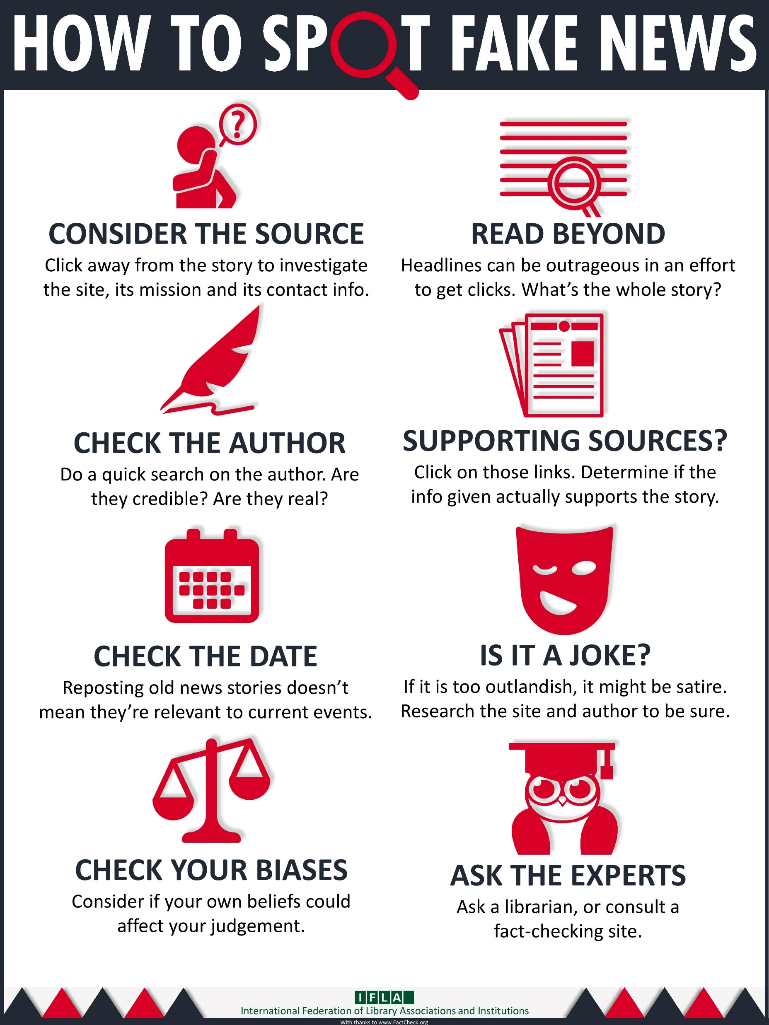
Statistics Can Lie
Check for red flags in studies
Chance
Quality (or lack)
Correlation vs causation
Context and conflicts
Make sure that you can spot “fake news” and that you don’t repeat incorrect information to others.
Give out a list of reliable immunization resources https://www.vaccineinformation.org/wp-content/uploads/resources/p4012.pdf
This Photo by Unknown Author is licensed under CC BY
Notes:
Statistics can lie – check out red flags in studies -
Chance – need a good sample size with rigorous and targeted study of limited endpoints
Quality – systematic reviews, RCTs, cohort trials, observation, expert opinion
Cherry picking data – limit, omit data or change the variables (especially time – like COVID vaccines and cumulative deaths.
Correlation vs causation – higher use of health care likely to result in higher rate of diagnosis; older people more likely to get vaccinated, but also more likely to die.
Context and conflicts – e.g. autism with expanded awareness, broader diagnostic criteria and financial incentives for diagnosis.

Slide 31
Media Monitoring
Tells you what and how and why information is spreading
Evaluation by tracking/analyzing/organizing/reacting to data
Use Webcrawlers and keywords
  Talkwalker – tracks health related conversations based upon queries, providing insights into public sentiment; realtime; free and paid versions
  Google – Google Trends & Google Alerts – data analysis of search query patterns;
  CrowdTangle – monitors social media conversations, tracks trends on Facebook and Instagram
Improve public health by identifying and responding to
  Gaps in knowledge
  Syndromes through surveillance – e.g. reactions to meds, epidemics,
  Misinformation
Be able to target responses ( to area/communities/ethnic groups)
Notes:
What and how and why information is spreading
Social listening to understand what information is spreading and
Understand people who interact with the information
Evaluation by
Tracking
Analyzing
Organizing
Reacting
Use of Webcrawlers and keywords
Stay up to date
Track questions/concerns
4 platforms
Talkwalker – tracks health related conversations based upon queries, providing insights into public sentiment; realtime
Free version – shows last 7d
Paid version – all capabilities, unlimited history
Implementation – put in hashtag
Google – Google Trends, Google Alerts –
data analysis of search query patterns;
customized info monitoring, including rising and top searches (helps to gauge prevalence of conversations or questions about specific issues) and state/local info; doesn’t cover social media content nor website reactions
CrowdTangle – monitors social media conversations, tracks trends on Facebook and Instagram (access needs to be granted by Meta), BUT can download extension called LinkChecker, which doesn’t require a CrowdTangle account.
Improve public health by identifying and responding to
Gaps in knowledge
Syndromes through surveillance – e.g. reactions to meds, epidemics,
Misinformation
Be able to target responses ( to area/communities/ethnic groups)
EARS – Early AI-supported Real-Time Online Social Listening of COVID-19 Conversations, sponsored by WHO
HealthMap.org re unsafe food
PGP – public good project – re vaccine conversations

Slide 32
SUMMARY
We all have a responsibility to vulnerable populations and health of the public
Presume all want best health possible for themselves and their families.
Move hesitant individuals by listening, respecting and use of motivational interviewing
Be a resource for the science of vaccines.
Be aware of circulating misinformation (local as well as national) about vaccines.
Spread science-based evidence-based knowledge
Advocate for vaccines
Work with partnerships – community influencers, trusted messengers
Maintain open doors/open minds
Notes:
Need to restore trust, build confidence in vaccines
a. Oath to public service, responsibility to vulnerable populations and health
b. Spread science-based evidence-based knowledge
c. Presume all want best health possible for themselves and their families.
Move individuals by listening, respecting and use of motivational interviewing,
Be a resource for vaccine knowledge. Update and Increase your knowledge of vaccines and answers to frequently asked questions. Promote vaccines in the office and on media.
e. Work with partnerships – community influencers, trusted messengers
f. Maintain open doors/open minds

Slide 33
Resources
Building Trust and Bridging Gaps https://www.nfid.org/podcast/building-trust-and-bridging-gaps-with-reed-v-tuckson-md/ D.C. Public Health Commissioner during HIV/AIDS
Vaccine hesitancy is nothing new. Here’s the damage it’s done over centuries. https://www.sciencenews.org/article/vaccine-hesitancy-history-damage-anti-vaccination
WHO vaccine leader on eroding trust in public health. WBUR | By Asma Khalid, James Perkins Mastromarino, Published May 13, 2025 at 11:53 AM EDT https://www.wvtf.org/2025-05-13/who-vaccine-leader-on-eroding-trust-in-public-health
Pulling ‘Vaxxed’ still doesn’t retract vaccine misconceptions https://www.sciencenews.org/blog/culture-beaker/pulling-vaxxed-still-doesnt-retract-vaccine-misconceptions
12 Influencers Are Behind Most Anti-Vax Hoaxes On Social Media, Surprising Research Reveals https://www.huffpost.com/entry/anti-vaccine-disinformation-dozen-social-media-influencers-covid-19_n_609f0d84e4b03e1dd389db79
Infodemiology Training Program https://www.infodemiology.com/training-resources/ deBeaumont Foundation.
Fam Pract Manag. 2023 Mar;30(2):19-23. Addressing COVID-19 Vaccine Hesitancy: Eight Tips for a Better Conversation https://www.aafp.org/pubs/fpm/issues/2023/0300/vaccine-hesitancy.html
Statement from Leading Physician Groups on NIH Decision to Terminate Grants for Vaccine Hesitancy and Uptake Research https://www.aafp.org/news/media-center/statements/nih-decision-to-terminate-grants.html
Exclusive: Trump administration defunds autism research in DEI and 'gender ideology' purge By Robin Respaut and Jaimi Dowdell May 16, 20255:32 PM EDT https://www.reuters.com/business/healthcare-pharmaceuticals/trump-administration-cut-autism-related-research-by-26-so-far-2025-2025-05-16/
On autism and vaccines, there are lies, damned lies and statistics https://www.latimes.com/opinion/story/2025-05-13/autism-vaccines-robert-f-kennedy-jr-statistics
Four reasons for COVID-19 vaccine hesitancy among health care workers, and ways to counter them https://www.aafp.org/pubs/fpm/blogs/inpractice/entry/countering_vaccine_hesitancy.html
Change Management - Emotions in change https://www.leadershipsuccess.co/change-management/emotions-in-change#:~:text=The%20first%20reaction%20to%20major,fine%20the%20way%20it%20is%E2%80%9D.
Communicating science-based messages on vaccines. Bull World Health Organ. 2017 Oct 1;95(10):670-671. doi: 10.2471/BLT.17.021017. PMID: 29147039; PMCID: PMC5689193.
Tuckerman J, Kaufman J, Danchin M. Effective Approaches to Combat Vaccine Hesitancy. Pediatr Infect Dis J. 2022 May 1;41(5):e243-e245. doi: 10.1097/INF.0000000000003499. PMID: 35213864; PMCID: PMC8997018.
MacDonald NE, Butler R, Dubé E. Addressing barriers to vaccine acceptance: an overview. Hum Vaccin Immunother. 2018 Jan 2;14(1):218-224. doi: 10.1080/21645515.2017.1394533. Epub 2017 Nov 29. PMID: 29048975; PMCID: PMC5791591.
https://theconversation.com/game-theory-explains-why-reasonable-parents-make-vaccine-choices-that-fuel-outbreaks-256975
www.AAFP.org , www.AAP.org, https://www.chop.edu/vaccine-education-center , www.immunize.org

