Slide 1

Presenter: Mikaela Kluver, MPH

Slide 2
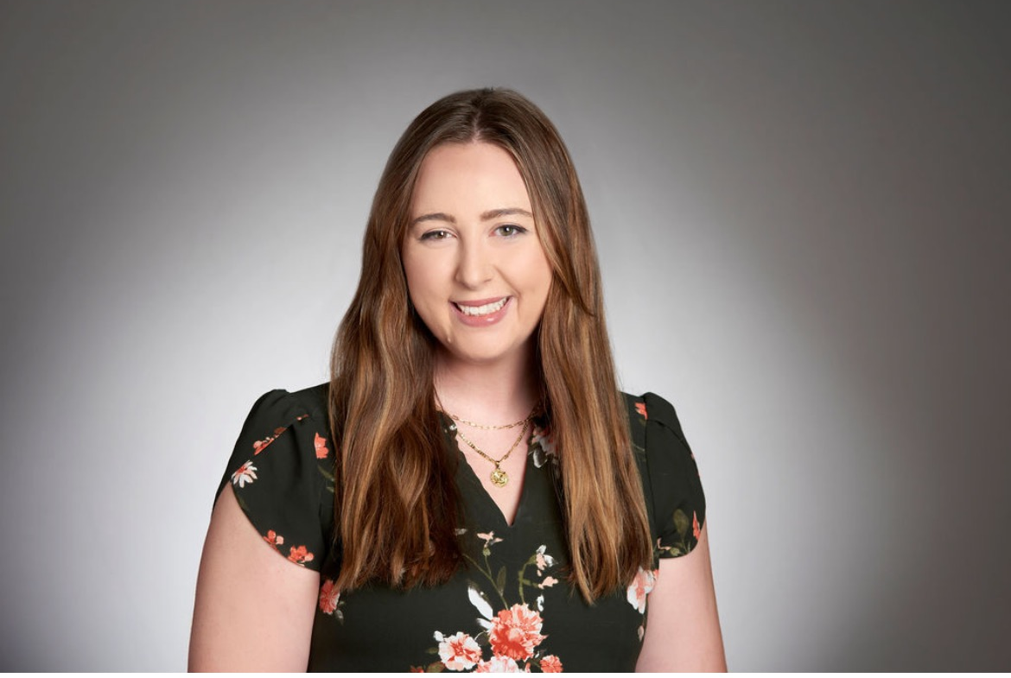
Who I am
Mikaela Kluver ACIC Community Outreach Coordinator BS Biobehavioral Health MPH Epidemiology Background in research, community outreach, epidemiology, and public health

Slide 3
History & Goals
Founded in 2005
Main goals:
  Education
  Advocacy
  Membership
  Education
  Advocacy
  Membership
Comprised of:
Physicians
Nurses
Pharmacists
Teachers
Human services staff
Public health professionals
Community members.
Anyone interested in vaccine education and promotion!

Slide 4
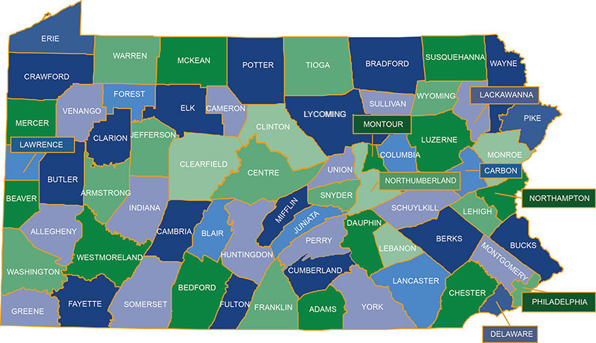
“Greater Pittsburgh Area”

Slide 5
Grant Goals 2024-2025
Volunteer engagement
Online presence
Student Engagement and Collaboration
Community Outreach
Member Engagement

Slide 6
Volunteer Engagement
Needs assessment was sent out to membership in the beginning of 2024
Upon draft of 2024 – 2025 RFP Community Outreach Committee was established
Expectation of joining:
  Once a month a committee meeting is 1 hour in duration. This would be on Microsoft Teams unless we want to occasionally meet in person.
  Commitment to attend at least 1 outreach event annually and be active in the committee with bringing information on upcoming events in the community or other ideas of how to better and sustain our efforts. All ideas are welcome!
On average 8 to 12 people attended the monthly meetings

Slide 7
Metrics
2023-2024 Total = 33 2024-2025 Total = 70

Slide 8
Student Intern
** ENTER IN TAYLORS SUMMARY – LIKE MINE **

Slide 9
Main Roles
Social media management
Assist in Community Outreach Committee
Assist with coordination of outreach events

Slide 10
Social Media Impact
LinkedIn Profile
Addition of Loomly subscription

Slide 11
Metrics
** add in some kind of metrics of followers before we started having help of # of posts and # of followers (July 2024 vs now and if possible month over month) also engagement percentage

Slide 12
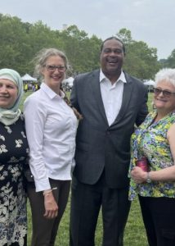
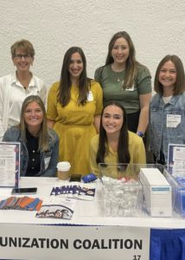
Ways to get involved
Attend quarterly meetings – in person and virtual
Community Outreach
Local Conference
Annual state-wide conference

Slide 13
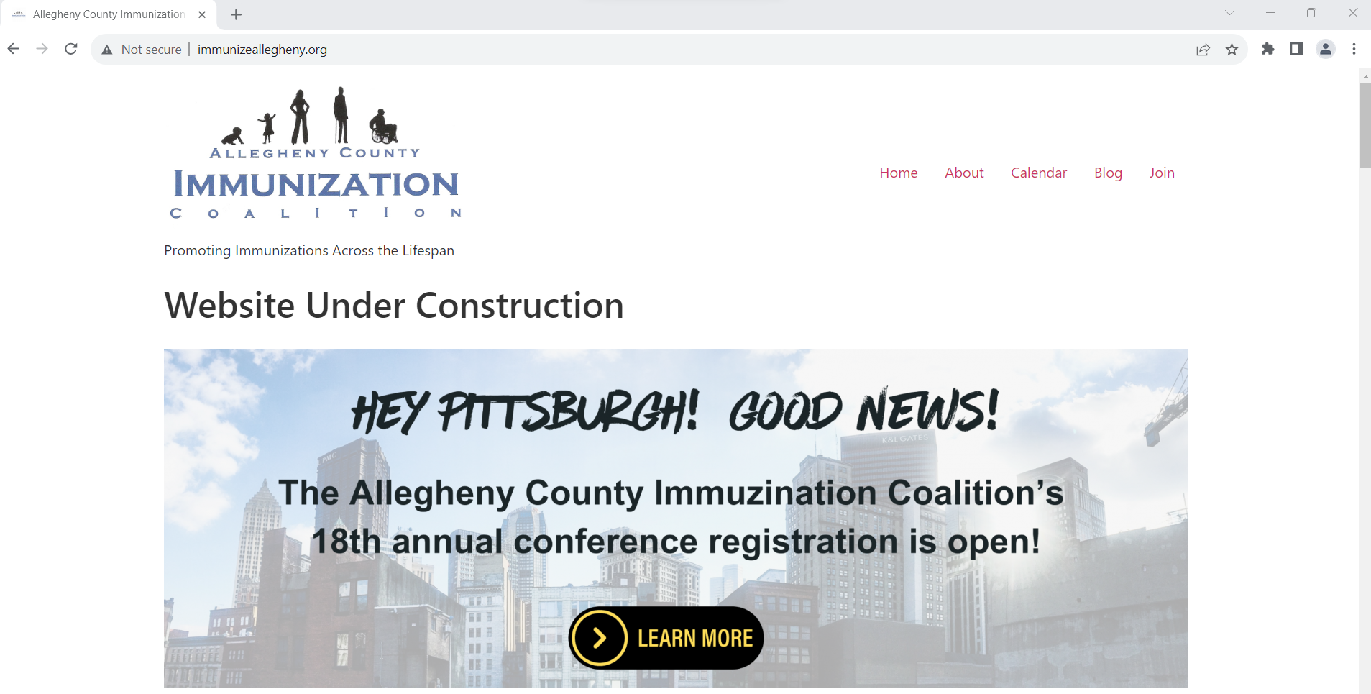
Join ACIC
FREE membership
Visit www.immunizeallegheny.org

Slide 14

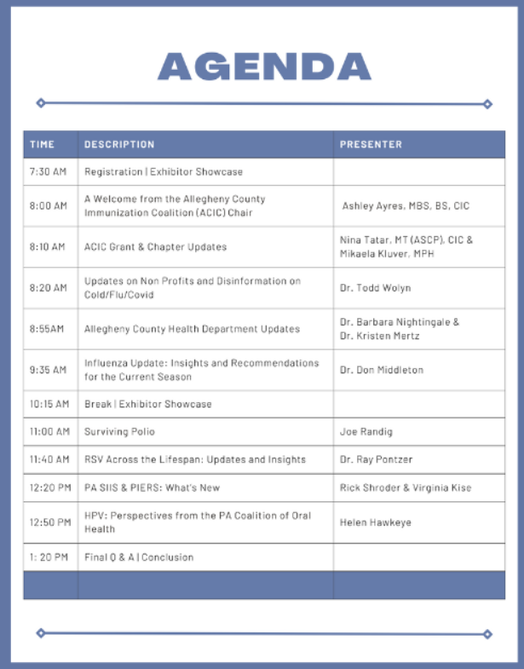
Upcoming Local Conference

Slide 15
Questions? Feel free to reach out!
Mikaela Kluver
Email: mkluver@paaap.org
Cell: 316-641-6008

